Slide 1


Green Pace
Security Policy Presentation
Developer: Priscilla Gomes-DaCosta

Slide 2

OVERVIEW: DEFENSE IN DEPTH
All electronic devices used for business purposes requires appropriate firewall to be installed and properly maintained.

Slide 3
THREATS MATRIX
Likely The likelihood the vulnerability will affect the system | Priority High urgency the vulnerability should be addressed
Low priority Less urgency in addressing the vulnerability | Unlikely The vulnerability has low likelihood of happening
Different secure code vulnerabilities have different severity levels.

Slide 4
10 PRINCIPLES
1. Validate Input Data
2. Heed Compiler Warnings
3. Architect and Design for Security Policies
4. Keep It Simple
5. Default Deny
6. Adhere to the Principle of Least Privilege
7. Sanitize Data Sent to Other Systems
8. Practice Defense in Depth
9. Use Effective Quality Assurance Techniques
10. Adopt a Secure Coding Standard

Slide 5
CODING STANDARDS
Do not cast to an out-of-range enumeration value
Do not define a C-style variadic function
Do not declare or define a reserved identifier
Do not write syntactically ambiguous declarations
Overload allocation and deallocation functions as a pair in the same scope
Avoid information leakage when passing a class object across a trust boundary
Avoid cycles during initialization of static objects
Do not let exemptions escape from destructors or deallocation functions
Do not modify the standard namespaces
Do not define an unnamed namespace in a header file

Slide 6
ENCRYPTION POLICIES
Encryption in rest
Encryption at flight
Encryption in use

Slide 7
TRIPLE-A POLICIES
Authentication
Authorization
Accounting

Slide 8
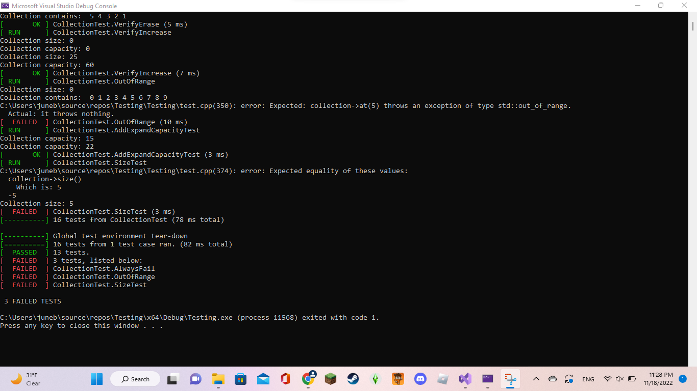
Unit Testing
In the example on the left, tests were created to verify:
Adding a single value to an empty collection
That max size is greater than or equal to size for 0, 1, 5, 10 entries
And so on…

Slide 9

AUTOMATION SUMMARY

Slide 10
TOOLS
DevSecOps pipeline
SAST
DAST
IAST
SCA
Vulnerability scanners

Slide 11
RISKS AND BENEFITS
Risks:
Denial of service
Compromised secrets
Loss of service
Damage to system
Benefits:
Reduced Failure Rate
Optimization of Development Time
Security of the Software
Corporate Secure Coding Structure

Slide 12
RECOMMENDATIONS
PREVENTION IS BETTER THAN CURE
Most common security gaps:
Unpreparedness
Unknown threats
Lack of monitoring
Open to fraud
Third party / vendor risk
Incident handling
People risk

Slide 13
CONCLUSIONS
ISO/IEC 27001 – Information Security Management Systems
ISO/IEC 27002 – Information Technology
ISO/IEC 27701 – Privacy Information Management Systems
National Institute of Standards and Technology (NIST) Cyber Security Framework (CSF)
Cyber Essentials
Payment Card Industry/Data Security Standard (PCI/DSS)

Slide 14
REFERENCES
10 common gaps in cyber security. (n.d.). Business & Personal Insurance Solutions | Chubb. https://www.chubb.com/vn-en/articles/10-common-gaps-in-cyber-security.html
Frechette, K. (2022, June 8). The advantages of secure coding best practices. GoldSky Security | Cyber Security Solutions. https://www.goldskysecurity.com/security-by-design-the-advantages-of-secure-coding-best-practices/
Likelihood - Glossary | CSRC. (n.d.). NIST Computer Security Resource Center | CSRC. https://csrc.nist.gov/glossary/term/likelihood
Michali. (2022, September 15). What is a DevSecOps pipeline? Check Point Software. https://www.checkpoint.com/cyber-hub/cloud-security/devsecops/what-is-a-devsecops-pipeline/
Security standards you should adopt in your organization | Soveren. (2022, December 2). Protect your sensitive data. https://soveren.io/blog/which-security-standards-should-you-adopt-in-your-organization
Secure coding: A practical guide. (2022, August 17). Mend. https://www.mend.io/resources/blog/secure-coding/
Silverstone, A., & CISSP. (n.d.). Where defense in depth falls short. CSO
Online. https://www.csoonline.com/article/2124452/where-defense-in-depth-falls short.html
Understanding the hierarchy of principles, policies, standards, procedures, and guidelines. (2015, October 2). LinkedIn. https://www.linkedin.com/pulse/understanding-hierarchy-principles-policies-standards-wally-beddoe/
What is secure coding? (2019, July 15). Perforce Software. https://www.perforce.com/blog/sca/what-secure-coding

